Slide 1

Lesson Four Ionizing Radiation
The Harnessed Atom

Slide 2
What you need to know about Ionizing Radiation:
Types of radiation
Non-ionizing
Ionizing
Forms of ionizing radiation
Alpha particles
Beta particles
Gamma rays
Radiation
Decay chain
Half-life
Dose
Radiation measurements
Sources of radiation
Average annual exposure

Slide 3
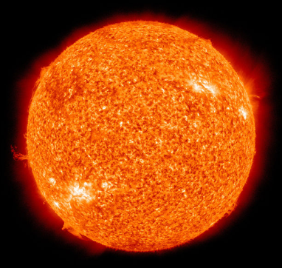
You are surrounded.
You are always surrounded by radiation. Radiation is everywhere.
The bricks in your school have natural minerals that are radioactive.
Cosmic radiation from the stars showers us constantly.
Radioactive minerals were in the banana you ate this morning.
Think of radiation as a natural energy that surrounds us all the time.
Notes:
Ask students if they know what this image is. This photo of the Sun was taken by NASA's Solar Dynamics Observatory. Make the point that radiation is part of our natural world and has been since the birth of our planet.
The Sun is one source of natural background radiation. Other sources include minerals in the soil, bricks on houses and buildings, even the potassium in bananas and other foods. Bananas contain potassium-40, also a naturally occurring radioactive material.

Slide 4
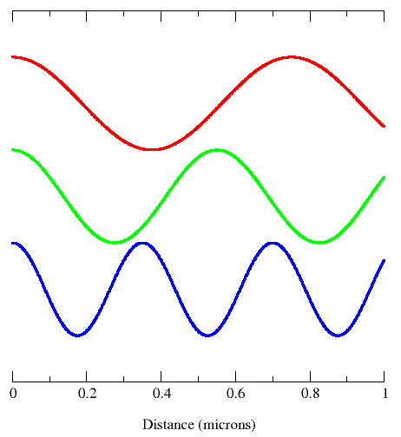
Radiation is moving around you.
Radiation is energy moving through space as
Waves
Particles.
Waves move in patterns like these. Electricity, for example, moves in wave patterns.
Particles travel more slowly than waves but still travel very fast. Examples of particles are
Alpha particles
Beta particles.
Notes:
This figure shows three electromagnetic modes (blue, green and red) with a distance scale in microns along the x-axis. Tell students that the wavy lines here show the wave forms of electric and magnetic (EM) fields. Light itself is an EM wave. EM energies are determined by the frequencies (the number of waves or cycles per second) not their speed. All types of electromagnetic radiation travel at the speed of light (186,000 miles/sec or 3 x 10^8 m/s).
Alpha and beta particles are not part of the electromagnetic spectrum. They travel at very fast rates but are slower than the speed of light.

Slide 5


Two types of radiation
Non-ionizing radiation is low energy. We use it to carry signals to our radios, TVs, and cell phones.
Ionizing radiation is high energy. We use it for medical x-rays. Its high energy can cause disease or it can treat disease.
Notes:
Microwave ovens also use non-ionizing radiation. Other examples include electric light bulbs, microwaves, and radio waves.

Slide 6
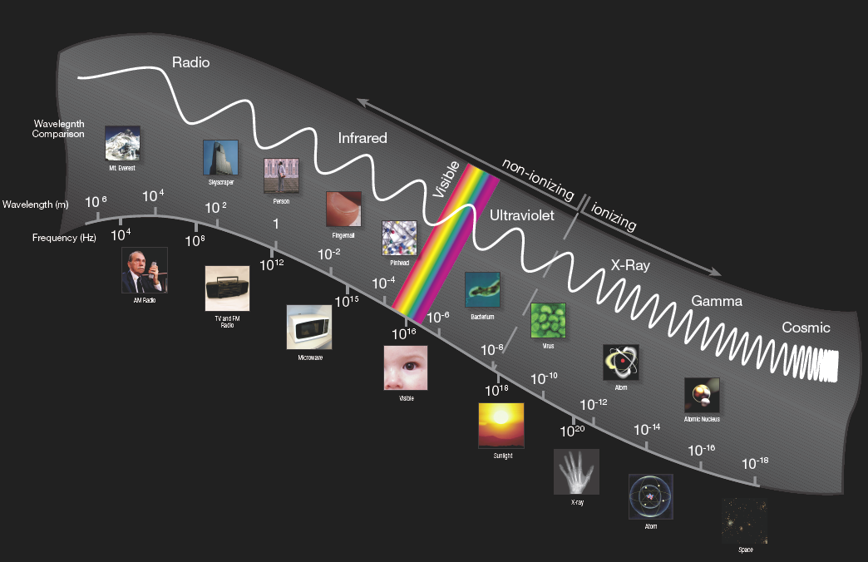
The energy spectrum of radiation looks like this.
Low frequency radiation is non-ionizing radiation. High frequency radiation is ionizing radiation.
Notes:
Spectrum may be a new word for your students. Tell them a spectrum is an orderly range of qualities or ideas. For example, a rainbow is a spectrum of color. This spectrum shows the orderly increase from non-ionizing to ionizing radiation. On the left of the illustration, low frequency radiation is non-ionizing radiation. On the right, high frequency radiation is ionizing radiation. Note the changing pattern of the waves. Ask students: Does this mean the ionizing waves are faster? (No. The wave patterns show the frequency.)
Ask students to think of the rays of the Sun. At first they warm us. Then make us sweat or burn. Too much of that Sun over time can cause skin cancer. Radiation at the high-energy end of the UV spectrum can be as dangerous as x-rays.

Slide 7
What to remember
Non-ionizing radiation Ionizing radiation
Low energy High energy
Low frequency High frequency
The dividing line between ionizing and non-ionizing radiation is whether the radiation carries enough energy to remove an electron from a molecule or an atom.
Notes:
Tell students: The lower the energy the lower the frequency of the non-ionizing radiation. The higher the energy the higher the frequency for ionizing radiation. The difference between ionizing and non-ionizing radiation is whether the radiation carries enough energy to remove an electron from a molecule.

Slide 8
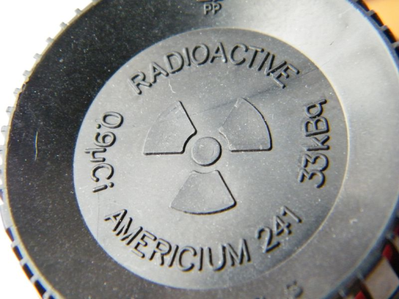
What do unstable isotopes do?
Some unstable isotopes make themselves more stable by shooting out energy rays or particles. We call this energy radiation.
Substances that give off radiation in such a way are called radioactive.
Example:
Most smoke detectors contain americium-241. This radioactive element emits energy. When the energy is blocked by smoke, the detector activates the alarm. Here’s what it looks like inside the detector.
Notes:
Important safety note: Tell students not to dismantle a smoke detector.
Photo released in public domain by original copyright holder: 2010-11-05 22:10 3648×2736× (2974515 bytes) {{Information |Description = Photo of the Americium container in a smoke detector. The copyright holder grants any entity the right to use this work for any purpose, without any conditions, unless such conditions are required by law. However, as a courtesy, a link back to Wikipedia (http://www.wikipedia.org/) would be appreciated

Slide 9
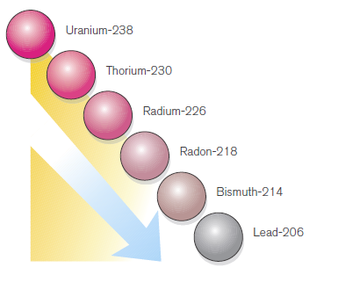
What else do unstable isotopes do?
Other unstable isotopes may give off particles from their nuclei and change into different elements. The process of isotopes emitting particles or rays to become more stable is called radioactive decay.
Notes:
Tell students that uranium is a radioactive element. This decay chain shows some of the steps in the uranium decay chain. The half-life of uranium-238 is 4.5 billion years.

Slide 10
One strange thing about radioactive isotopes…
Nobody knows exactly when a radioactive isotope will decay and release radiation.
Some isotopes may change in the next second, some in the next hour, some tomorrow, and some next year. Other isotopes will not decay for thousands of years.
In a group of atoms, a pattern can be seen. We describe this pattern by using the term half-life.
Half-lives range from fractions of a second to several billion years.
Notes:
Naturally occurring uranium is composed of three major isotopes, uranium-238, uranium-235, and uranium-234. All three isotopes are radioactive and create radioisotopes as they decay. The most abundant and stable is uranium-238 with a half-life of 4.51×10⁹ years (just about as old as the Earth itself). Uranium-235 has a half-life of 7.13×10⁸ years, and uranium-234 has a half-life of 2.48×10⁵ years.

Slide 11
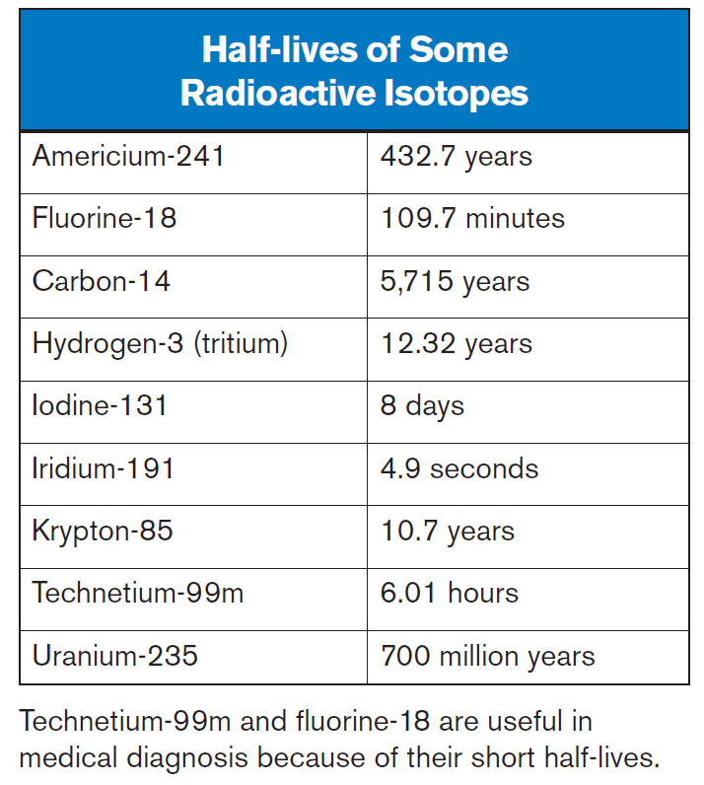
What is a half-life?
The amount of time it takes for a given isotope to lose half of its radioactivity is known as its half-life.
An unstable isotope will eventually decay into a stable element. However, this process is often drawn out into something called a decay chain.
We measure the decay in half-lives.
Notes:
Make sure students understand that when an atom decays, it changes into another element. It does not disappear.

Slide 12
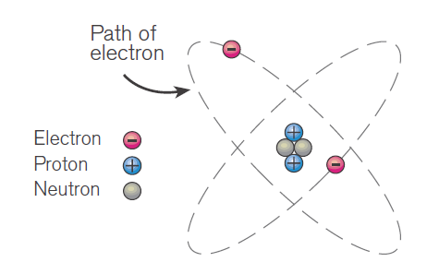
Ions have an electric charge.
An ion is an atom or a group of atoms that have gained or lost an electron.
Ions have an electric charge. Ions are formed when an electron or proton joins or leaves an atom, giving it a positive or negative charge.
Notes:
Ask students: Remember when we talked about the structure of the atom? We said the nucleus is in the middle and it’s made up of the positive proton and neutral neutron. Whirling around it are the electrons. They are negatively charged. The electrons want to stay in orbit around the electrons. That’s what the positive and negative forces do. They make them stay together.
Ionizing radiation, from say the isotope uranium-235, has enough energy that when it interacts with an atom, it can remove those tightly bound electrons from their orbit. When that happens the atom is no longer balanced with equal numbers of protons and electrons: the difference creates an electric charge.
Remember from an earlier lesson: unstable isotopes emit energy as radiation. Unstable isotopes are constantly emitting ionizing radiation. Radiation is the term given to the particles and/or energy emitted by radioactive material as it disintegrates….as it becomes more stable. We call that process decay.

Slide 13
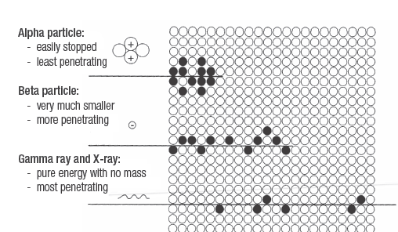
How do the types of ionizing radiation deposit energy?
Types of ionizing radiation differ widely in their abilities to penetrate tissue and deposit energy through ionization. Because it can knock electrons from atoms and molecules, ionizing radiation can change human tissues.
Image: Penn State
Notes:
We have to be careful with ionizing radiation . Alpha particles are not very penetrating and can be stopped by a piece of paper. But they deposit all their energies in a small area and can do a lot of damage if they are eaten or inhaled. Tell students that the cluster of black dots show how concentrated the energy is.
Beta particles are more penetrating and deposit much less energy at any one point. Note that the energy is more spread out.
Gamma rays and x-rays are waves of pure energy, without mass or charge.

Slide 14

What is radiation protection?
Radiation dose is determined by the amount of
Time that a person is exposed to ionizing radiation
Shielding used protect a person
Distance between a person and a radioactive substance.
UV rays in sunlight are non-ionizing radiation, but the same principles apply.
Notes:
Ask students to think about their exposure to the non-ionizing radiation from the Sun’s rays. Ask how the three words, (time, shielding, distance) matter with Sun exposure. How do these factors affect “absorption” of radiation?
Answer: If you spend short amounts of time in the Sun each day, or limit your exposure by wearing sunscreen and clothing (shielding), your skin will be much healthier than if you spend an entire day on the beach in just your bathing suit (ouch!). Distance is also a factor: risk of sunburn increases with proximity to the tropical latitudes, where the Sun is closer to the Earth. Also the time of day determines the height ratio to the sunbather, creating the greater risk at noon when the Sun is overhead and shadows are minimal.
Now that students understand the dose determination, compare the limits of time, shielding, and distance to ionizing radiation. Ask students what protection workers might need. This discussion leads to the next slide.

Slide 15
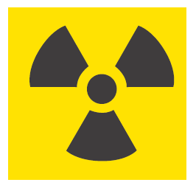
What does this symbol mean?
This symbol is used on packages of radioactive materials, such as isotopes, and on doors to rooms or areas where radioactive materials are used or stored.
Why do we use it?
Notes:
Answer: We need this symbol because we cannot detect radiation with our senses and because exposure to too much radiation is harmful. This symbol alerts people to be cautious.
Remind students that this symbol must be on containers when radioactive materials are shipped by truck, train, plane, or ship. You have probably seen the symbol if you have had an x-ray.
Ask your students if they can name or describe the caution symbol for “flammable” on trucks carrying gasoline. Can they think of other caution symbols we use?

Slide 16
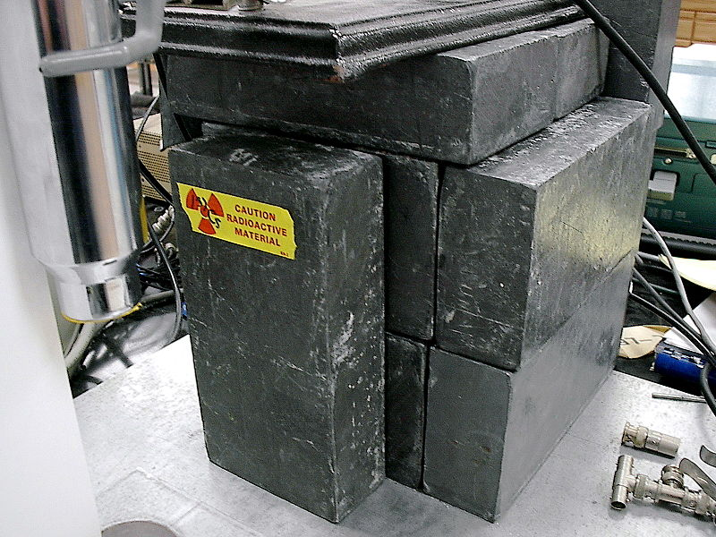
Radiation protection on the job
Ionizing radiation is widely used in industry and medicine. Workers need to take precautions against particle radiation and electromagnetic radiation.
Time
Shielding
Distance
What precautions are taken here?
Notes:
Answer to question on slide: Lead bricks being used to shield a radioactive sample (Cesium-137) in a laboratory. Cesium-137 is used to calibrate radiation-detection equipment. It is used as a gamma emitter for oilfield wire line density measurements. It is also sometimes used in cancer treatment. It is also used in industrial gauges for measuring liquid flows and the thickness of materials. The label on the lead bricks also illustrates the importance of distance for workers.
Radiation exposure in industry can be managed by:
Time: An example of reducing radiation doses by reducing the time of exposures might be improving operator training to reduce the time it takes to handle a source.
Distance: Distance can be as simple as handling a source with forceps rather than gloved hands.
Shielding: In x-ray facilities, the walls with the x-ray generator contains barium sulfate and the operators stay behind a leaded glass screen. They may also wear lead aprons.
This photo has been released into the public domain by its author, L. Chang 3-17-2004. Changlc grants anyone the right to use this work for any purpose, without any conditions, unless such conditions are required by law.

Slide 17
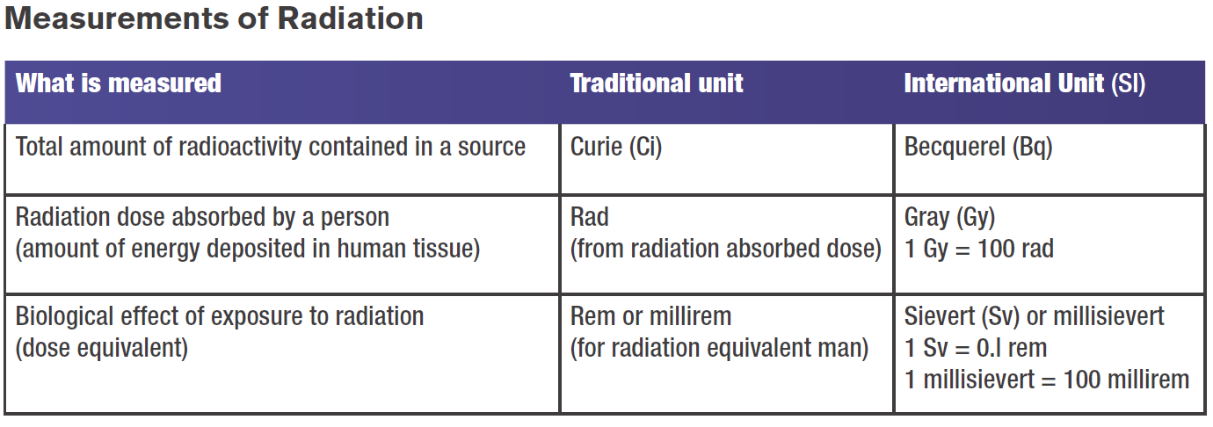
Ways of measuring ionizing radiation
Notes:
Tell students: We measure how much radioactivity is in a substance with Becquerel (Bq). We measure the activity of the source in units of disintegrations per second or curies.
We measure the radiation absorbed by the object in units of radiation absorbed doses or rads.
The unit that matters most to us in our every day lives is the millisievert or millirem. These units describe the effect ionizing radiation has on people.

Slide 18
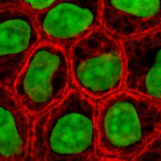
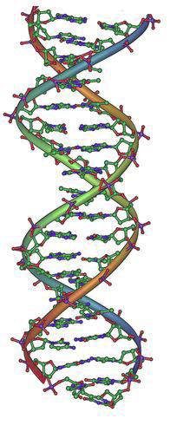
Can exposure to ionizing radiation harm you?
It can. Damage depends on how much and how long.
Very high exposure received in a short time can cause death.
Low levels over a long time may cause little damage and your body’s cells can usually repair themselves.
Sometimes the cell makes an incorrect repair. The effect of incorrect repair could show up years later as cancer.
ion
Notes:
Unstable isotopes emit energy as radiation. This damage could be properly repaired by cellular mechanisms, improperly repaired causing a genetic mutation, or it could result in the death of the cell.
Cells that rapidly divide, have a long dividing future, and are less specialized are more sensitive to radiation. For this reason, the blood-forming cells in the bone marrow are most sensitive, followed by the cells in the lining of the intestine and the reproductive organs. Muscle and nervous system cells are less sensitive. Radiation is used to treat cancer because cancer cells fit this description and are more likely to be sensitive to radiation. The developing embryo/fetus also meets this description of sensitivity.
Illustrations from http://pbadupws.nrc.gov/docs/ML1117/ML111720092.pdf

Slide 19
What is your exposure to radiation?
In the U.S., we are exposed to an average of 6.2 mSv per year
Notes:
The main natural sources of radiation (50% background in red in pie chart) we are exposed to are:
• terrestrial radiation from the rocks and soils around us, (about 7 percent of natural background radiation comes from elements like potassium, uranium, and thorium. Most soils around the world contain at least small amounts of these elements These elements constantly decay and emit radiation. )
• solar particles and cosmic radiation from space,
• radon in the atmosphere,
• the radioactive materials in our bodies, mainly from what we eat or drink.
The blue pie slice is the average medical radiation exposure. The average yearly dose of ionizing radiation in the United States is increasing mainly because of more use of radiation in medicine. As imaging technology improves, doctors are using x-rays and CT scans more and more for diagnosis. At the same time, treatments using radiation are also improving, and doctors are also using radiation to treat diseases, such as cancer. As a result, the average yearly exposure for a person in the United States has risen from 3.6 millisievert (360 millirem) in the 1980s to 6.2 Sv (620 millirem). Remind students that these are averages, meaning that many people receive less and many receive more, depending on where they live and what their activities are.
Students may be concerned when they learn that we are all exposed to low levels of radiation every day. Is background radiation dangerous to our health? This is a very hard question to answer. Even experts disagree. But most experts agree that there is little, if any, danger from the background radiation, which is always present in our environment and always has been, because it is part of nature.

Slide 20
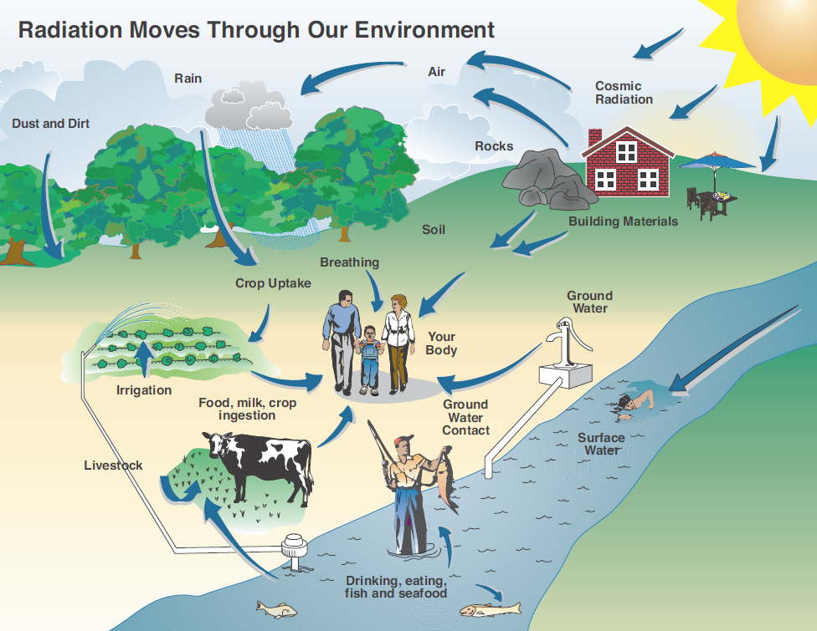
Where does your radiation exposure come from?
Notes:
In the United States, the average person receives about 6.2 millisievert (620 millirem) a year. About half of this is from natural radiation and half is from medical procedures.
The arrows in this illustration show pathways that radiation moves through the environment.
Everything in the world is radioactive and always has been. The ocean we swim in, the mountains we climb, the air we breathe, the foods we eat and the water we drink all expose us to small amounts of radiation from nature. This is because unstable isotopes that emit non-ionizing and ionizing radiation are found everywhere.

Slide 21


Who is exposed to the most space radiation?
Space radiation consists of solar particles and cosmic rays from outer space.
Who is exposed to the most space radiation: the skier or the fisherman at the ocean?
Notes:
Space radiation consists of solar particles and cosmic rays from outer space. It accounts for about 11 percent of the total dose from background radiation. Much of this radiation is filtered by the Earth’s atmosphere, so elevation affects your exposure from space radiation. It is also affected by how close you live to the equator. In Denver (farther from the equator and higher altitude) the dose is 0.7 millisievert (70 millirem). This means a skier at a mountain resort will receive more background radiation than a fisherman at sea level.

Slide 22
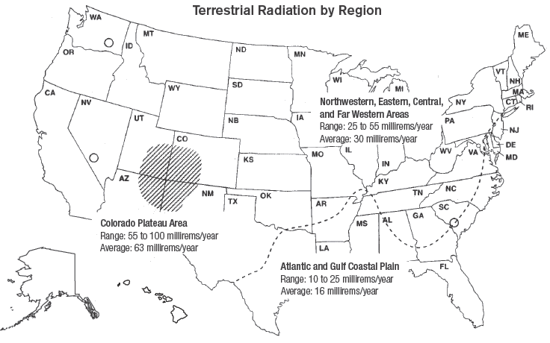
Who is exposed to the most terrestrial radiation?
Terrestrial radiation comes from elements found in common soil. Most soils contain some elements like potassium, uranium, or thorium.
Notes:
The average dose to an individual in the United States from terrestrial sources is about 0.2 millisievert (200 millirem) per year. However, there are some variations over the country, and the average exposure takes the population of regions into account. On the coastal plains of the Atlantic and Gulf regions, the average annual dose is lower than it is in the mountains in the western United States.
Ask students to find the State they live in or have lived in and calculate their terrestrial radiation dose. Who is exposed to the most terrestrial radiation: Gulf Coast or Utah residents?

Slide 23


What is internal radiation?
Internal radiation is found in plants, animals, and people. All living things are made of elements, including some radioactive ones.
Which nut has more radioactive elements: Brazil nuts or walnuts?
Find out about more consumer products that are radioactive at
http://www.orau.org/ptp/collection/consumer%20products/consumer.htm
Notes:
Potassium and carbon are radioactive elements found inside the human body. Americans get about 2.68 millisevert (268 millirem) of radiation each year from the food they eat, milk or water that they drink, and elements they breathe in. Of course, this number varies depending on what they eat or drink, where it is grown, and how much is eaten. However, all foods contain some radioactive elements, and certain foods – bananas and Brazil nuts, for example – container higher amounts than most other foods. It’s important to remember that potassium and carbon are essential for our health.
Highlight the url with your cursor. Right click from your mouse to select “Open Hyperlink.”

Slide 24
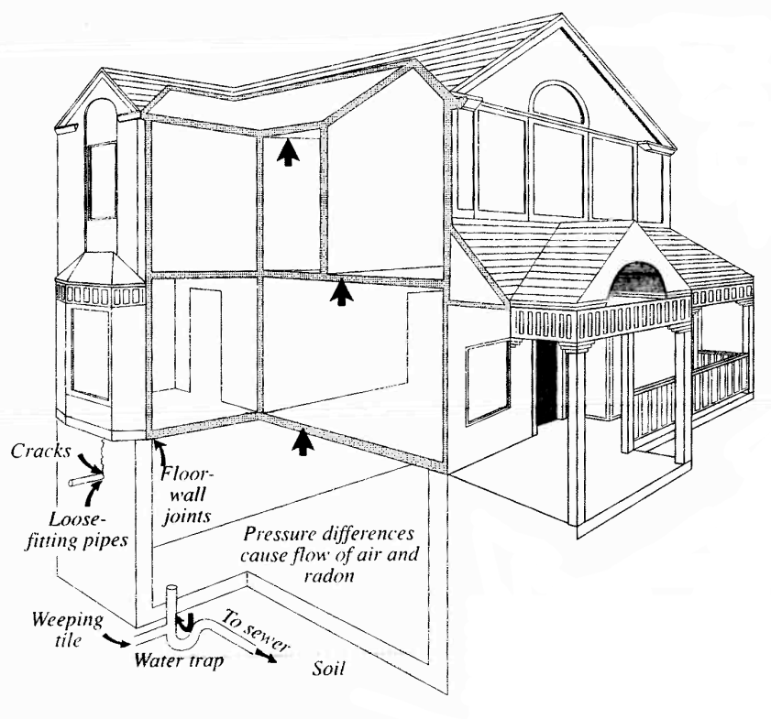
What is radon?
Radon is a radioactive gas that comes from the normal decay of uranium found in nearly all soils and water. It is part of the background radiation you receive everyday.
Notes:
Radon is a component of background radiation. It has no color, odor, or taste. Radon can get into our buildings through cracks and other holes in the foundation. When this happens, it can build up in indoor air. Radon gas decays and gives off tiny radioactive particles that may be inhaled. These particles can damage lung tissue. Testing is the only way to know if a building or home has elevated radon levels.

Slide 25
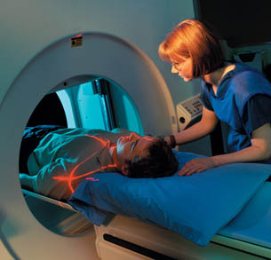
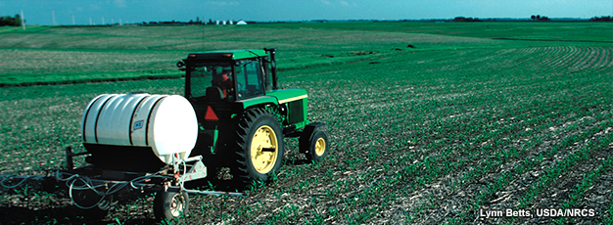
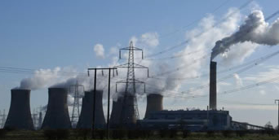
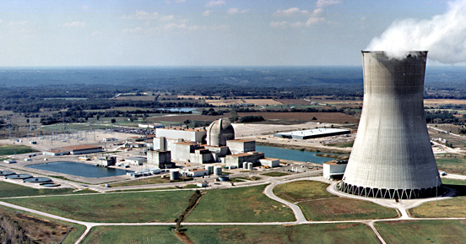
What are some human-made sources of radiation?
We can get additional amounts of radiation from
X-rays, CT scans, and other medical treatments
Cigarettes
Fertilizers and agriculture
Building materials (bricks, wood, stone)
Generating electricity from coal, gas, biomass, or nuclear power
Notes:
One estimate is that smoking half a pack of cigarettes a day 365 days a year exposes a smoker to 18 millirem of radiation a year. Tell your students that you do not want them to smoke cigarettes. Smoking is a deadly addiction.
Studies show that ash from coal-fired power plants is a larger manmade source of radiation exposure than nuclear plants. For a person living within 80 kilometers (50 miles) of a nuclear plant, exposure is 0.01 mrem annually; for a person living within 80 kilometers (50 miles) of a coal-fired plant, exposure is 0.03 mrem annually. Radioactivity is present in the coal that is mined, but the ash that results is more concentrated. We also get radiation from the nuclear power industry. Of the two, coal has more radioactivity released.

Slide 26
Summary: Fill in the blanks
Radiation is energy moving through space in the form of waves and particles.
Radiation is a part of natural world and has been since the beginning of our planet.
Radiation can be described as non-ionizing (low energy) or ionizing (high energy).
Some important forms of ionizing radiation are alpha and beta particles, gamma rays, and x-rays.
The main natural sources of ionizing radiation we are exposed to are called background radiation.
Notes:
The answers are in the sentences above. You can turn this page into an activity using your cursor to highlight the blank spaces. Use your toolbar to make the answers’ font not white.
Review these facts with students before or after a quiz.

Slide 27
Summary: Fill in the blanks
Unstable isotopes change by emitting particles or energy rays in a process called radioactive decay.
As an unstable atom decays, it changes to a different element. Eventually, unstable isotopes decay to stable elements.
Nobody knows exactly when a radioactive isotope will decay and release radiation. In a group of atoms, a pattern can be seen. We describe this pattern by using the term half-life.
The half-life of an isotope is the amount of time it takes to lose half of its radioactivity by decay.
Notes:
The answers are in the sentences above. You can turn this page into an activity using your cursor to highlight the blank spaces. Use your toolbar to make the answers’ font not white.
Review these facts with students before or after a quiz.

Slide 28
Summary (continued)
Background radiation includes:
terrestrial radiation from the rocks and soils around us
solar particles and cosmic radiation from space
radon in the atmosphere
radioactive materials in our bodies mainly from what we eat and drink and breathe in.
Notes:
The answers are in the sentences above. You can turn this page into an activity using your cursor to highlight the blank spaces. Use your toolbar to make the answers’ font not white.
Review these facts with students before or after a quiz.

Slide 29
Summary (continued)
There are also human-made sources of radiation. These include medical uses such as x-rays and CT scans and some products like smoke detectors.
The average yearly dose of ionizing radiation for a resident of the United States from all sources is 6.2 millisievert (620 millirem). Half comes from background radiation, 48 percent comes from medical uses, and 2 percent comes from consumer products or industry.
Because it can knock electrons from the atoms and molecules in its path, ionizing radiation can cause changes in human tissue.
Notes:
The answers are in the sentences above. You can turn this page into an activity using your cursor to highlight the blank spaces. Use your toolbar to make the answers’ font not white.
Review these facts with students before or after a quiz.

Slide 30
Summary (continued)
Most scientists believe low levels of exposure to radiation have an insignificant effect on people. If exposure is low or the radiation is received over a long period of time, the body can usually repair itself.
However, if an exposure is big enough, it can cause damage. Fortunately, exposures to large amounts are extremely unusual.
To minimize your risk, workers apply the rule of Time, Distance, and Shielding.
• Limit the length of time of exposure
• Increase the distance from a source
• Increase shielding.
Notes:
The answers are in the sentences above. You can turn this page into an activity using your cursor to highlight the blank spaces. Use your toolbar to make the answers’ font not white.
Review these facts with students before or after a quiz.

Slide 31
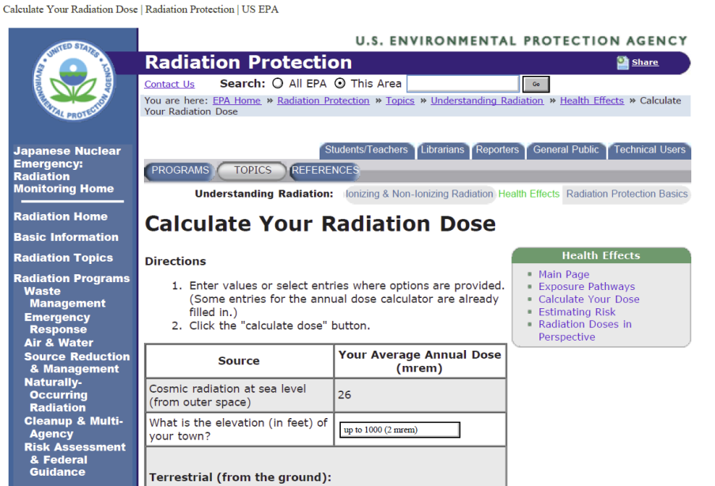
Advanced Student Assignment 1
Calculate Your Radiation Dose
http://www.epa.gov/rpdweb00/understand/calculate.html
Notes:
Highlight the url with your cursor. Right click from your mouse to select “Open Hyperlink.” The U.S. Environmental Protection Agency’s website will calculate your students’ radiation doses.
The dose calculator is based on the American Nuclear Society's brochure, "Personal Radiation Dose Chart". The primary sources of information we relied on are the National Council on Radiation Protection and Measurements Reports #92-#95, and #100. Please remember that the values used in the calculator are general averages and do not provide precise individual dose calculations.

Slide 32
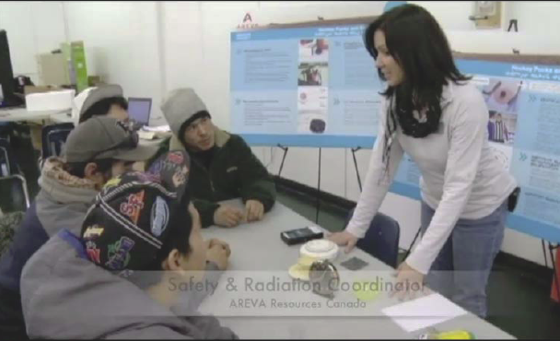
Advanced Student Assignment 2
In this demonstration, a technical expert talks to students about ionizing radiation. She also refers to precautions she and her coworkers take at the uranium ore mine where they work.
http://www.youtube.com/watch?v=d044cBnTS5w
Notes:
Highlight the url with your cursor. Right click from your mouse to select “Open Hyperlink.” This clip runs for ten minutes 48 seconds.

Slide 33
Lesson 4 Vocabulary
alpha particle – a type of radiation; a positively charged particle emitted by certain radioactive materials; alpha particles can be stopped by a piece of paper
averages – an estimation of or approximation to an arithmetic mean
background radiation – the natural radioactivity in the environment; most results from cosmic rays from space and from naturally radioactive elements
Becquerel (Bq) – an international unit of measure of how much radiation is in a substance; named for French physicist, Henri Becquerel.
beta particle – a type of radiation; a fast-moving electron that is emitted from unstable atoms that are becoming stable; beta particles can be stopped by aluminum foil

Slide 34
Vocabulary
cosmic radiation – a source of natural background radiation that originates in outer space and is composed of penetrating ionizing radiation
CT scan – a method of taking images of internal organs; combines x-rays and computer technologies; abbreviation for computerized axial tomography
curie (Cu) – a traditional unit of measure of the intensity of radioactivity in materials; named for Marie Curie, a Polish physicist and chemist famous for her pioneering research on radioactivity
decay chain – a sequence of radioactive decay processes in which the decay of one isotope creates a different isotope that itself undergoes decay, forming yet another different isotope
electromagnetic spectrum – the entire range of wave lengths or frequencies of electromagnetic radiation extending from gamma rays to the longest radio waves

Slide 35
Vocabulary
emit – to send out or put forth
gamma ray – a type of radiation released in waves by unstable atoms as they become stable; gamma rays can be stopped by lead
half-life – the amount of time needed for half of the atoms in a type of radioactive material to disintegrate or undergo radioactive decay
internal radiation – the radiation we receive from elements inside our body based on the food we eat, the water we drink, and the air we breathe
ion – an atom that has too many or too few electrons, causing it to have an electrical charge
ionizing radiation – radiation that has enough energy to remove electrons from substances that it passes through, thus forming ions

Slide 36
Vocabulary
ionization – the process of adding or removing one or more electrons to or from atoms or molecules, thus forming ions
millirem (mrem) – a traditional unit of measure of the biological effect of exposure to ionizing radiation; 1/1000 of a rem (see millisievert)
millisievert (mSv) – an international unit of measure of the biological effect of exposure to ionizing radiation; 1/1000 of a sievert; an international unit replacing millirem (see millirem)
non-ionizing radiation – low-energy electromagnetic radiation that does not have enough energy to remove electrons
radiation – fast particles and electromagnetic waves emitted from the center of an atom during radioactive decay or disintegration

Slide 37
Vocabulary
radiation dose –the amount of energy absorbed by an object or person per unit mass
radioactive – having the property of spontaneously emitting energy in the form of radiation as a result of the decay (or disintegration) of an unstable atom
radioactive decay – the spontaneous changing of the atom into a different atom or a different state of the same atom
radon – a colorless, radioactive gas formed by the decay of radium; contributes to the background radiation people are exposed to all the time from nature
rem - the traditional unit of absorbed does of ionizing radiation; from radiation equivalent man; being replaced by sievert, the international unit
sievert – an international unit of measure for the biological effect of exposure to ionizing radiation; an international unit replacing the traditional unit called rem

Slide 38
Vocabulary
space radiation – radiation from space; see cosmic radiation
terrestrial radiation – radiation coming from the Earth; contributes to the background radiation people are exposed to all the time from nature; for example, soil, rocks, and building materials
time, distance, shielding – a slogan for the three ways workers protect themselves from exposure to ionizing radiation
x-ray – electromagnetic radiation having a wave length that is much shorter than that of visible light with the power to penetrate matter

